Slide 1
BALANCE A Living Philosophy

Slide 2
BIO
Matt Presti
www.MattPresti.com
Metascientist, Musician, Patriot, Philosopher, Poet, Practitioner of Universal Law, Natural Science and Living Philosophy, Audio and Video Producer, Broadcaster, and Host of The Exploration of Consciousness (TEC). Former Director of Operations and President of The University of Science and Philosophy (formerly the Walter Russell Foundation) January 1st, 2015-August 10th, 2021. Currently CEO of Universal Power, LLC. Volunteer firefighter on Montauk Rural Fire Department in Dent County, Missouri and Rockfish Valley Volunteer Fire Department in Nelson County, VA.
Notes:
History – 7 years – SOL - NDE

Slide 3
Productions
The Secret of Light Series
A 19 part video breakdown on the Natural Science and Philosophy of Dr. Walter and Lao Russell.
Frank Chester – The Wonder of Seven
A documentary on the Chestehedron, a seven sided form created by Frank, which is the geometry surrounding the heart.
Knowing The Creator
A four part series based on the teachings of Walrer and Lao Russell and other cosmic illuminates throughout time-immemorial and creation as a process.
Innerviews
A series of nine presentations featuring people who were interested in the Russells and various aspects of their work.
Dispelling Dimensional Madness
This documentary was created to take down the "belief" in higher dimensions, mythematics and new age scientism.
Free Will & Evil
Going into production later 2024.

Slide 4
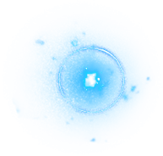
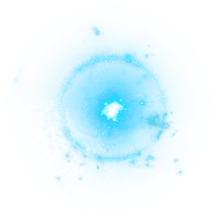
BALANCE – A living philosophy
Dr. Walter and Lao Russell
The University of Science and Philosophy
www.Philosophy.org

Slide 5
Notes:
History – Twilight Club

Slide 6
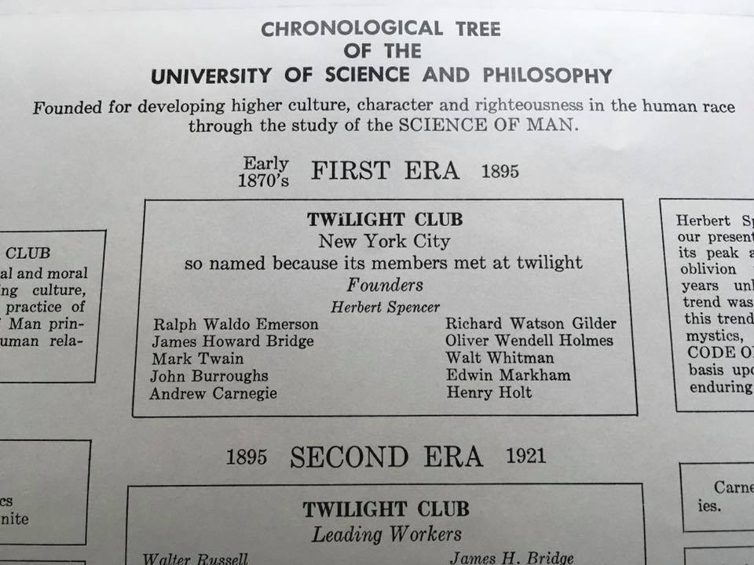
Notes:
History – Twilight Club

Slide 7
Notes:
40,000 words of illumination

Slide 8
BALANCE
The One & Only Law
If you need one word – Balance
If you need two words – Rhythmic-Balance
If you need three words – Rhythmic-Balanced-Interchange

Slide 10
GOD'S GREAT GIFTS TO MAN ARE LIFE AND THAT WHICH MAN CALLS DEATH
God's universe is based upon the love which He gives to His universal body as Life — and the love that His universal body re-gives to Him as Death for eternal re-borning as Life.
THIS NEW WAY OF LIFE is based upon the balanced perfection and normalcy of the love principle of Nature which never takes, but gives for the purpose of equally regiving that which has been given.
LIFE is the great gift of love which our Father-Mother has given to all Creation — and
DEATH is the great gift of love which all Creation regives to our Father-Mother for eternally resurrecting all Creation into equally balanced and divided two-way life sequences forever and ever. “

Slide 11
Practical Spirituality
Gets things accomplished
Is mutually beneficial
Is based on the “Law of LOVE.”
Exhibits balanced human relations
The scientific definition of Love is – “Giving for Regiving.”

Slide 12
God is Love
The foundation of love is BALANCE.
God’s universe is balanced by the two opposite pulsations which manifest love.

Slide 13
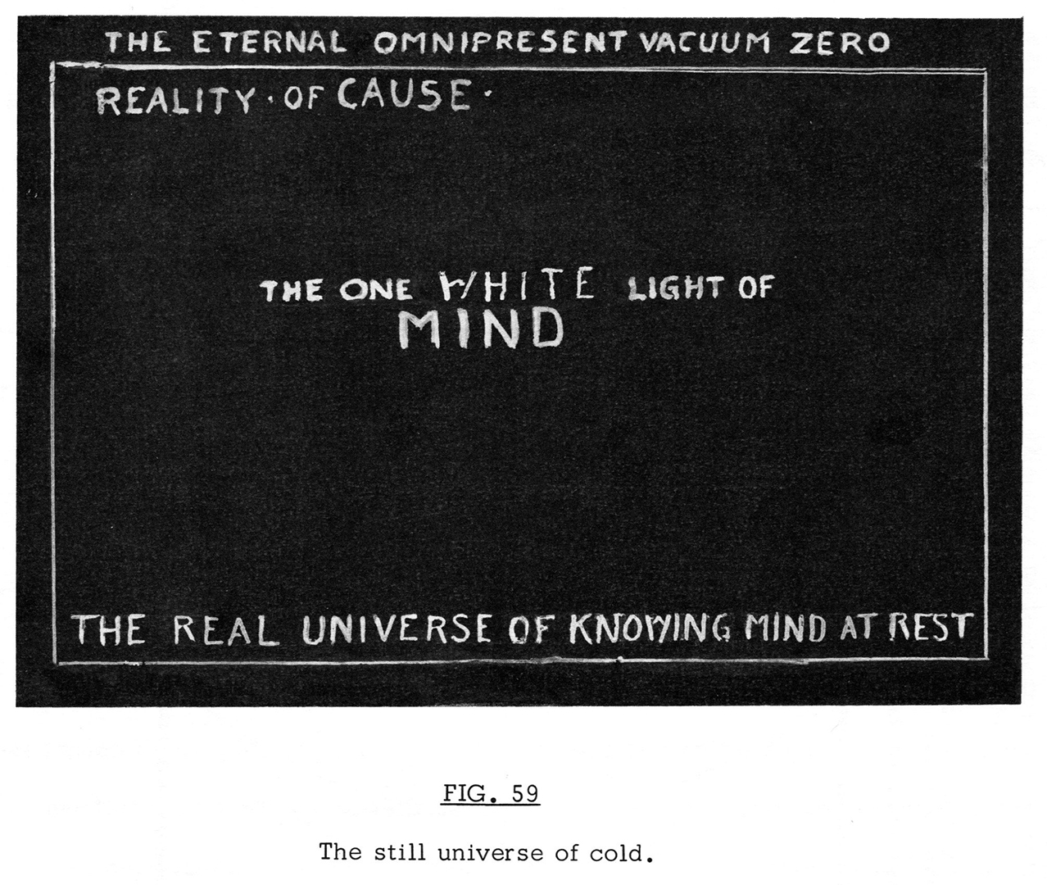
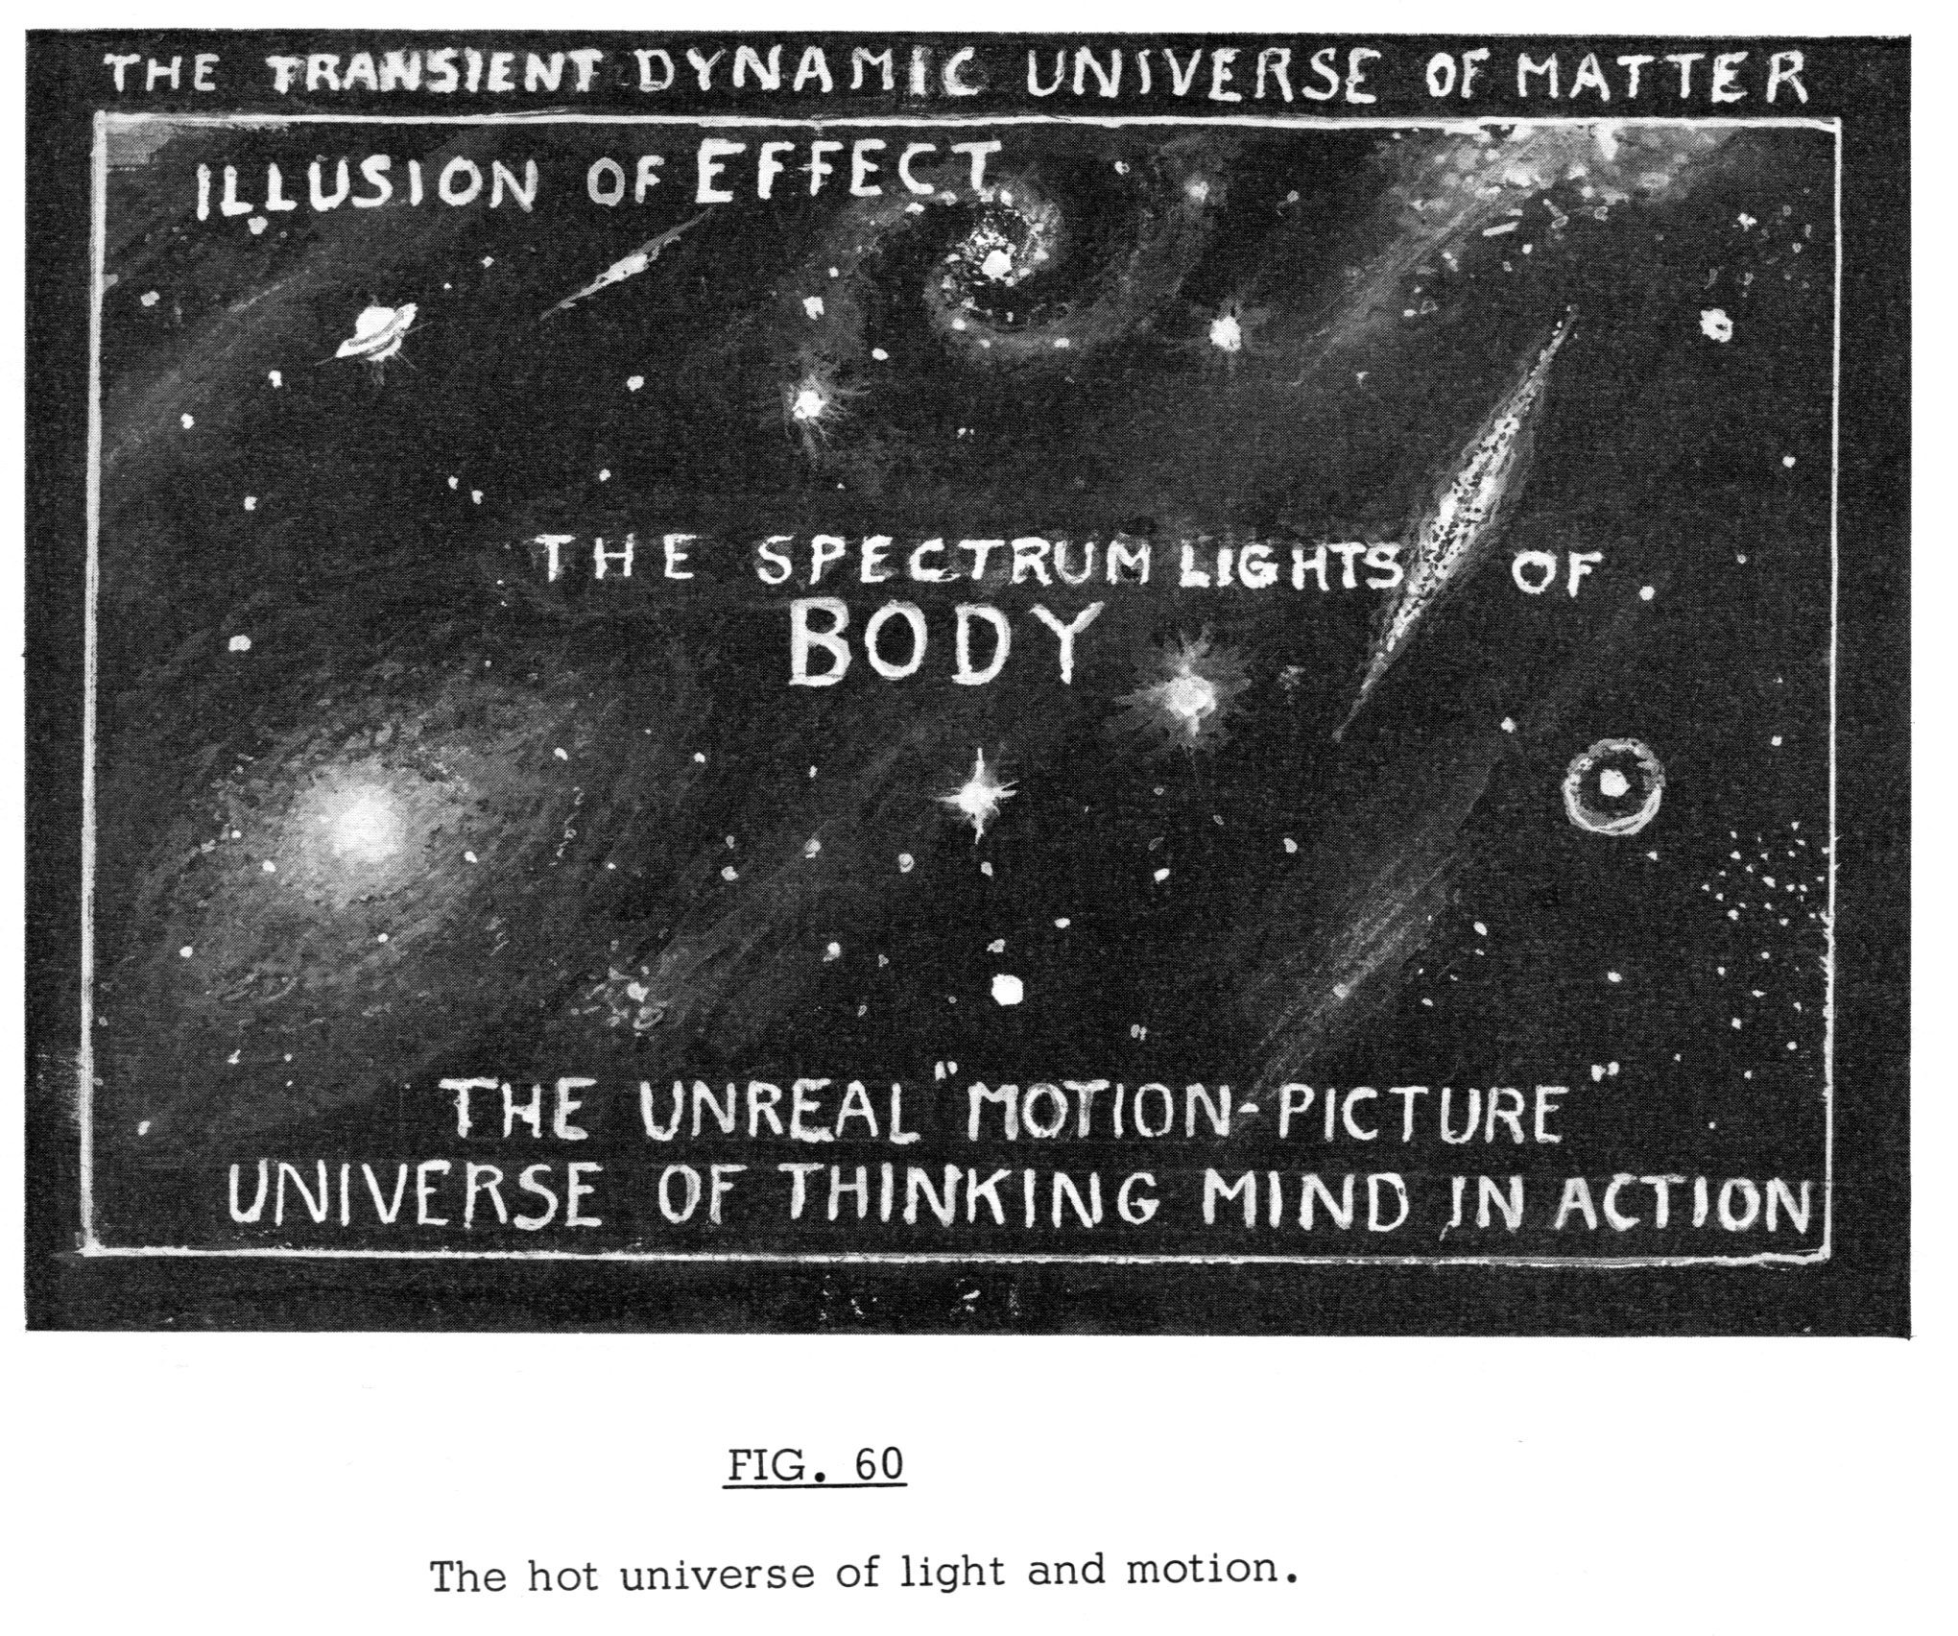
The Russell Cosmology

Slide 14
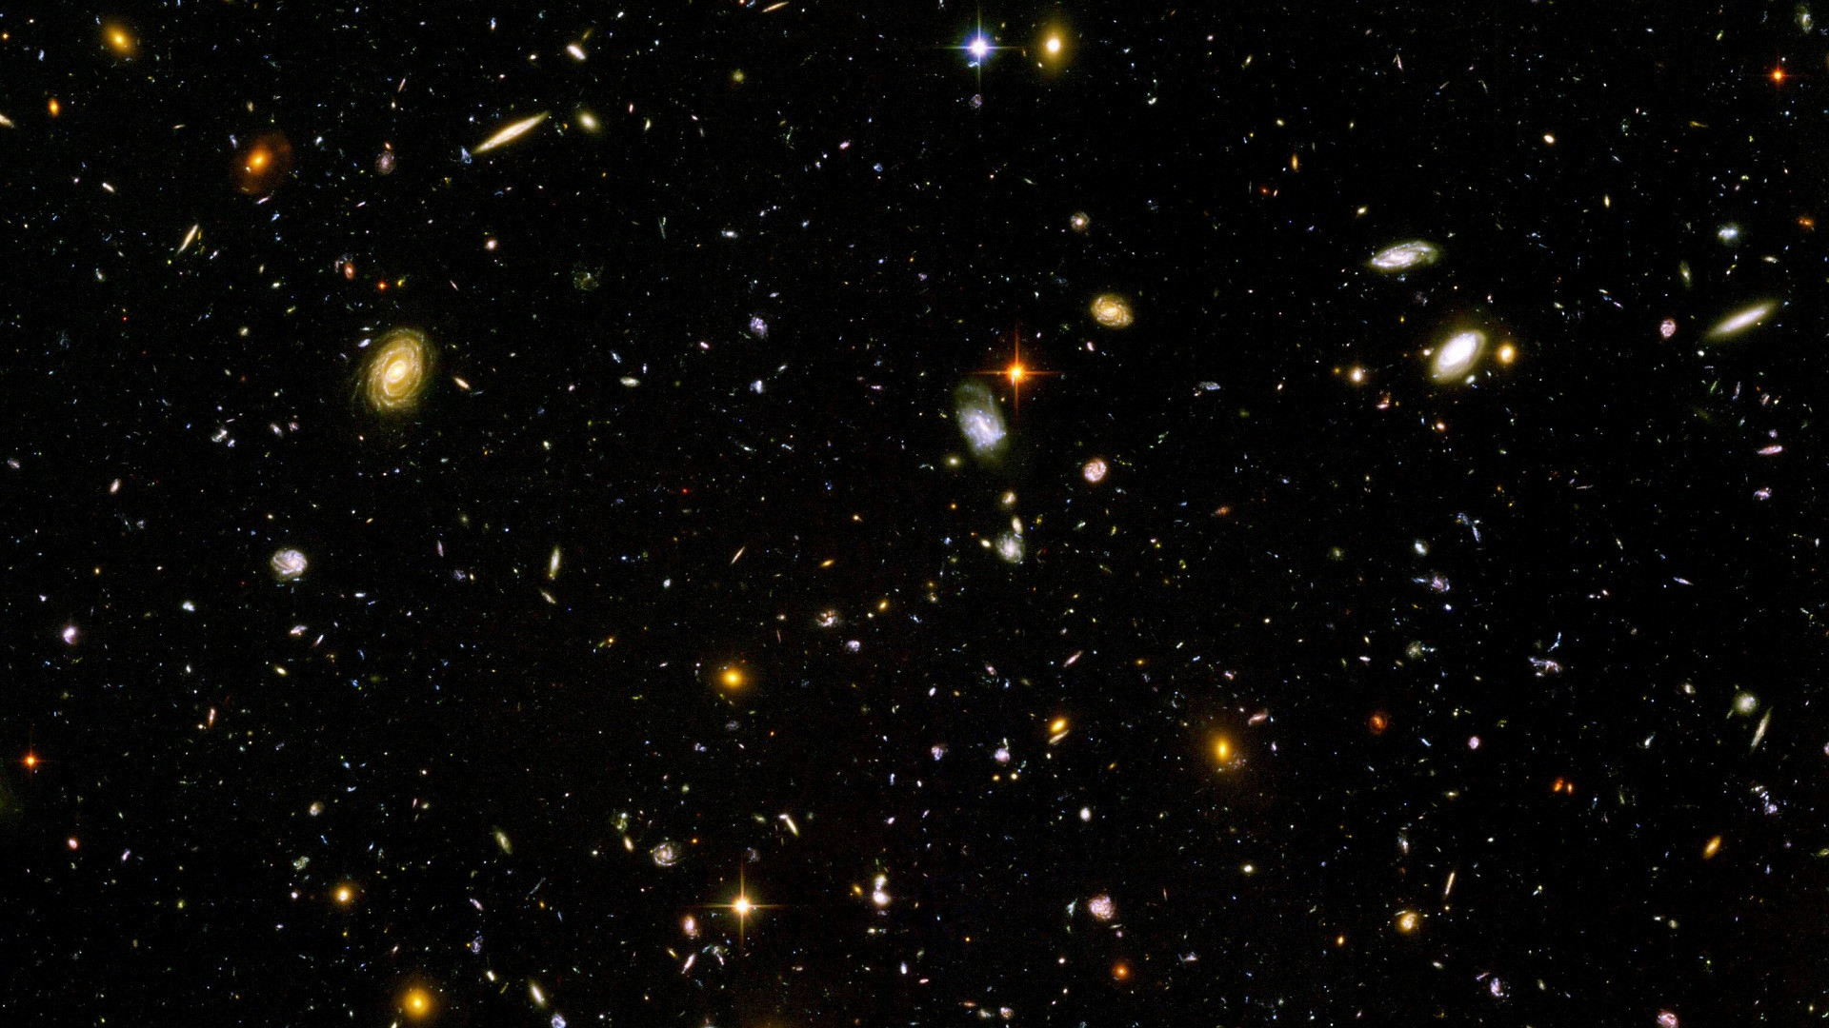
The Russell Cosmology
Mind
Matter

Slide 15
The Concept of Evil
The reaction to the giving of love is love regiven. When your meditation gives to you the love nature of God, you will then know that there is no evil, nor sin, nor bad in God or in Nature. The only sin on earth lies in not knowing. Do you not see that man becomes what he thinks, and if he thinks evil he becomes evil?
It is recorded that every man who has known the illumination into Cosmic Consciousness has first lost all awareness of sin or evil. He finds himself in a universe of love in which there is no evil.
"I am a patient God. All men will come to me in due time, but theirs is the agony of awaiting.“
And where shall I find love in this sordid world of fear where no peace is — of hatred where no love can be — of ugliness which stifleth beauty — and of evil which driveth love away?
Seek it within your Self.
When you find Self, you will find love, for naught but love is within Self.

Slide 17
This RESIDUE OF UNBALANCE is the answer as to whether there is such a being as Satan, or evil, or sin. Everything that man calls BAD, or EVIL, or SIN in his life is due to his own inability to balance his actions or his life. Ignorance of God’s Presence in him is the cause of that. Therefore he hurts himself and blames it upon an evil being. As man unfolds his spiritual nature, sin and evil disappear in the measure of that unfolding. Every Illuminate has described as the very first symptoms of his Illumination that all sense of sin, evil or shame disappears.
The Concept of Evil
📖

Slide 18
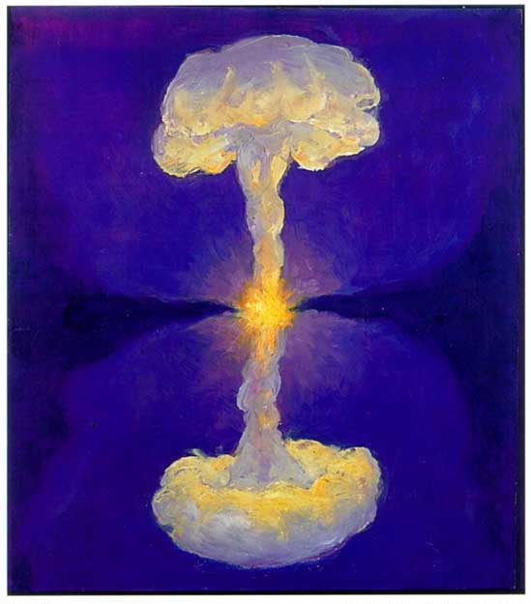
Go and sin no more. . .
Do you not see, therefore that sin and evil are man-made products which do not exist in Nature? Do you not also see that this world of fear and chaos is also manmade by talking fear, teaching fear and creating fear, even unto creating a God of fear? Balance is the master key which opens the door to life and love.

Slide 19
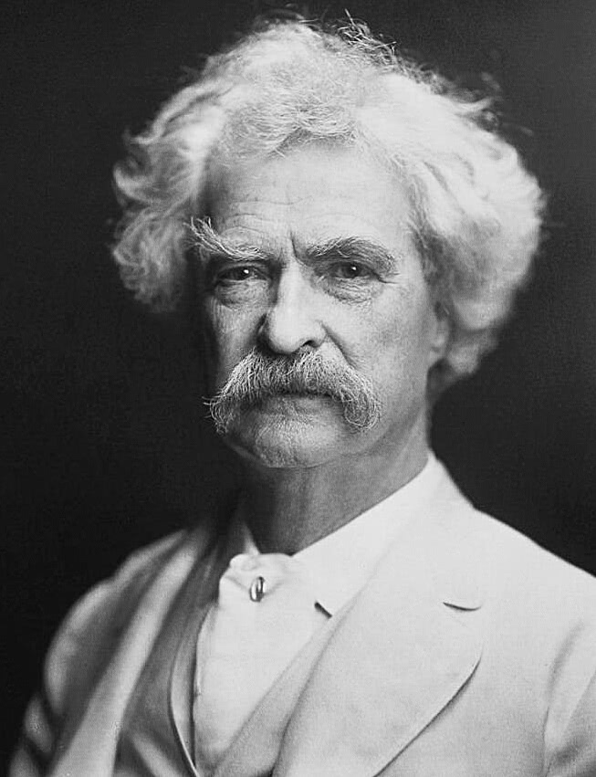
The Reality of Balance
“What is joy without sorrow? What is success without failure? What is a win without a loss? What is health without illness? You have to experience each if you are to appreciate the other. There is always going to be suffering. It’s how you look at your suffering, how you deal with it, that will define you.” ― Mark Twain

Slide 21
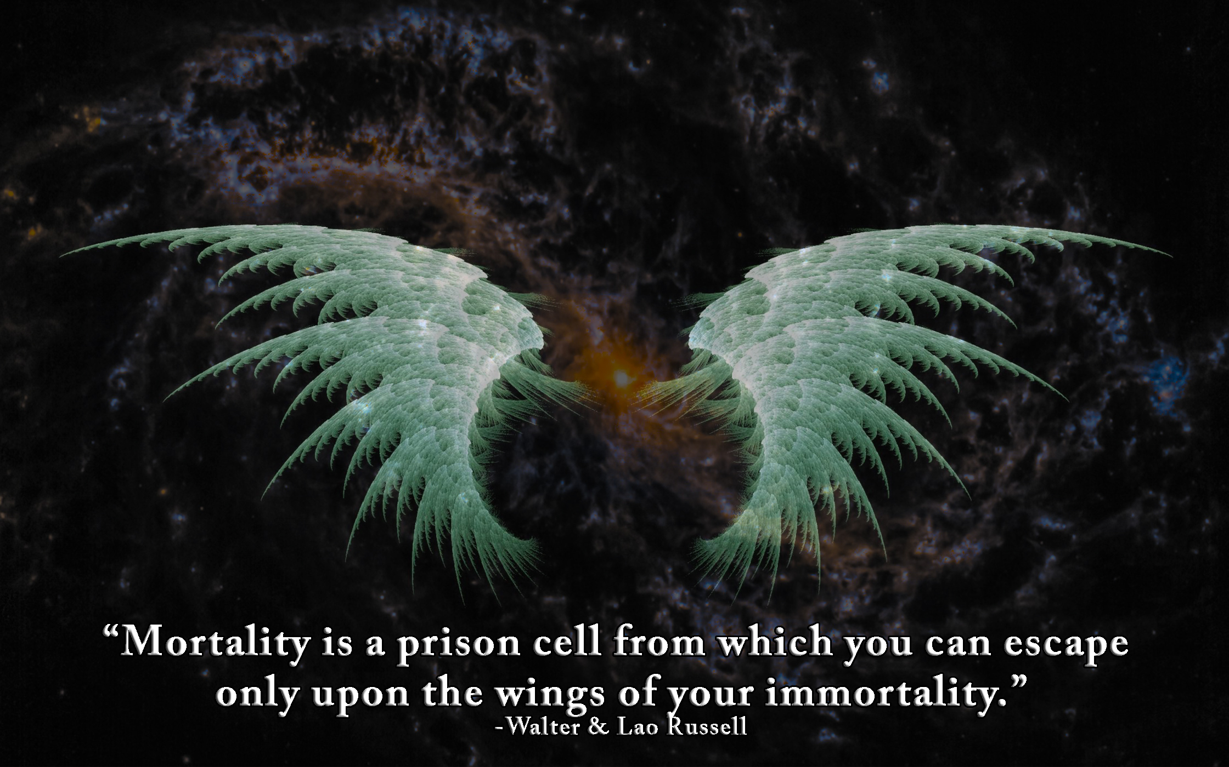

Slide 22
“Immortality isn't something you find in death, it is something you live in life.” ~MBP
I found out an interesting thing with my years of study about duality, eventually culminating into triality, which I first encountered in a realization while studying alchemical transmutation. I found out that I could be whole, on a wholly (Holy) different level. I could "rise above" my own internal conflict. I could see the world from my "eye" single. I could unify the opposites within my "SELF" as centre. My body then became an instrument, an appendage to my mind. Something to be used to fulfill my purpose—divine. I learned to listen to the whispers of my soul from the great halls of a silent heaven. ~MBP

Slide 23
Because straight is the gate, and narrow is the way, which leadeth to life, and few there be that find it.
~Matthew 7:14

Slide 24
“If you know the enemy and know yourself, you need not fear the result of a hundred battles.” ~Lao Tzu
The giants of humanity have echoed since time immemorial, that the best solution to the problems of the world lay in the middle (the narrow path), where the demarcation line of balance is to be found. Recognition of both opposites and worship of neither. In terms of freewill, good and evil are but a matter of degrees, or variables between opposites. Thus, the marriage of opposites in alchemy, Hermeticism, and spiritual practices remains as important today as ever. Who truly knows that both heaven and hell exist within simultaneously?
When doing right for the sake of right itself, balance is the sum of that equation in harmony with Nature. There is no residue left over despite the objections of the opposites. Nature will quickly confirm whether or not you chose wisely. And neither good nor evil, life nor death shall rule your temple. For only your soul may rule and command both. ~MBP

Slide 25
Notes:
Source: Jung Blog - Rather than interpreting alchemy as literally concerned with changing lesser metals into gold, Jung considered it a symbolic representation of the individuation process. Images in Medieval and Renaissance alchemy texts provided him with further validation of his theories regarding the universality of symbols. In the foreword to his Psychology and Alchemy, he wrote, "What the written word could express only imperfectly, or not at all, the alchemist compressed into his images."

Slide 28
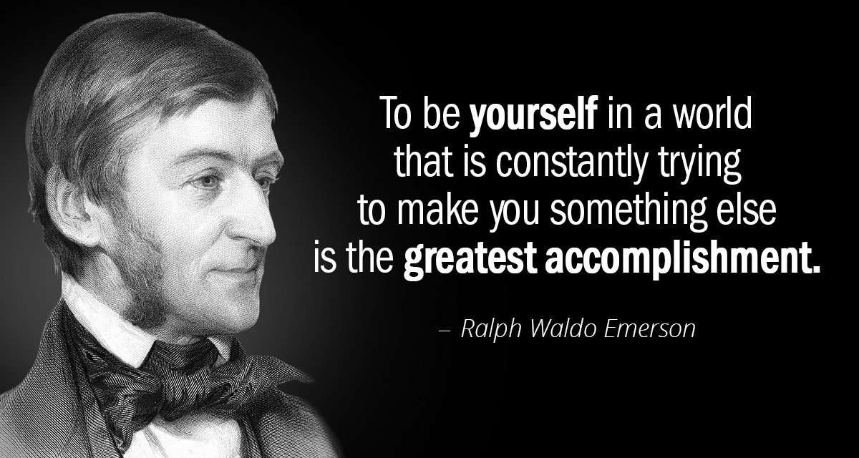

Slide 29
“To the extent that you know your universe and your power in it, you will build a balanced life of happiness and masterly achievement because you will be working knowingly with God when you do fully comprehend and practice the Law of Balance.” ~Walter & Lao Russell
The Reality of Balance

Slide 31
Notes:
Prana, Odic Force of Carl Reichenbach, Reich’s Orgone, Chi, Atman, Divine Will, Desire

Slide 32
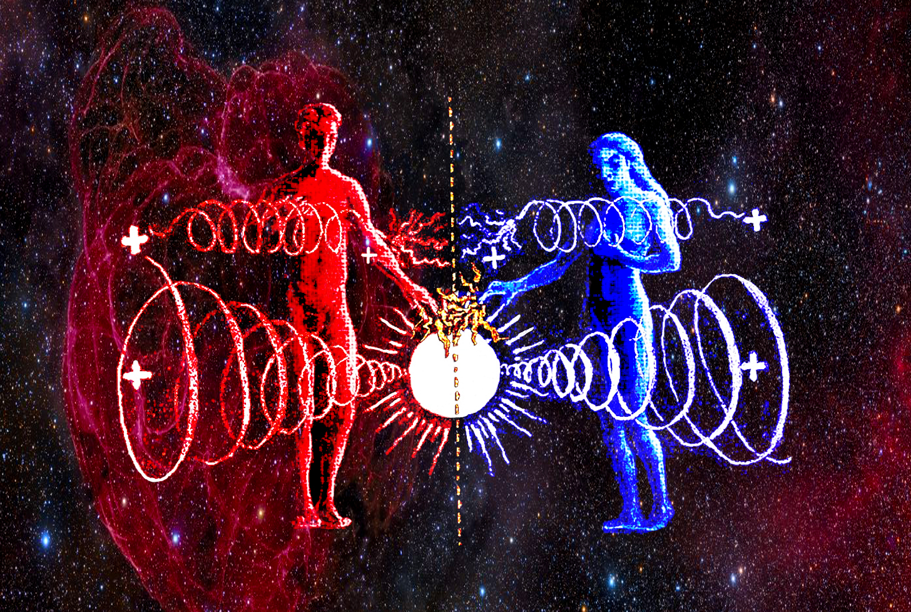
Notes:
We are but a mere chromosome different regarding our physicality

Slide 33
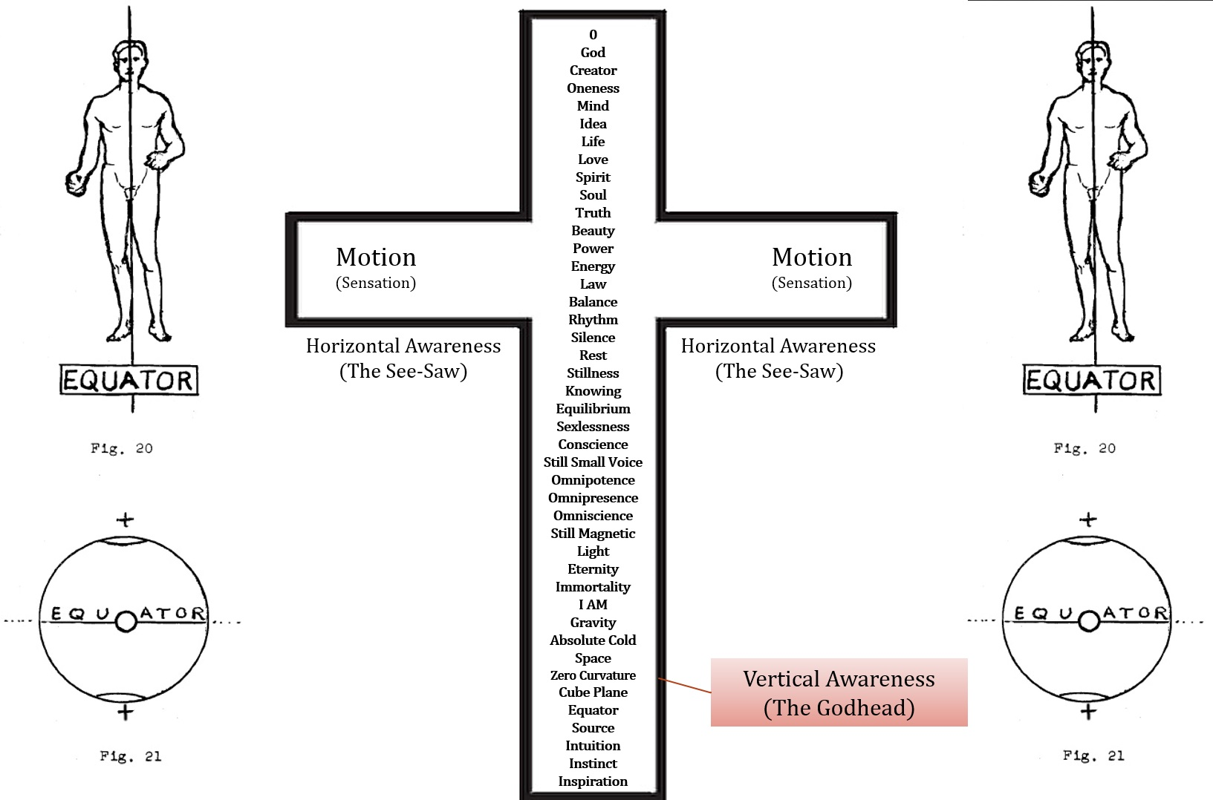

Slide 34
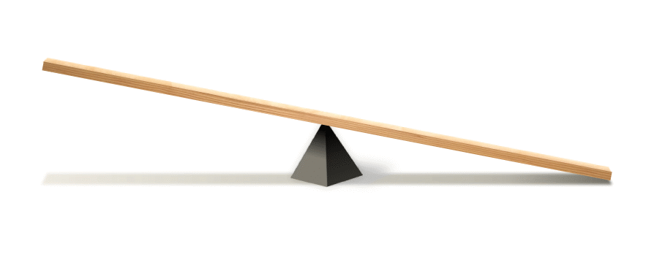
The Reality of Balance
BALANCE is the key that opens all doors. Unbalance is the lock that forbids one entry into the glory of a life triumphant.
BALANCE is simple unification of opposites. Stillness, silence, equilibrium, the fulcrum.

Slide 35
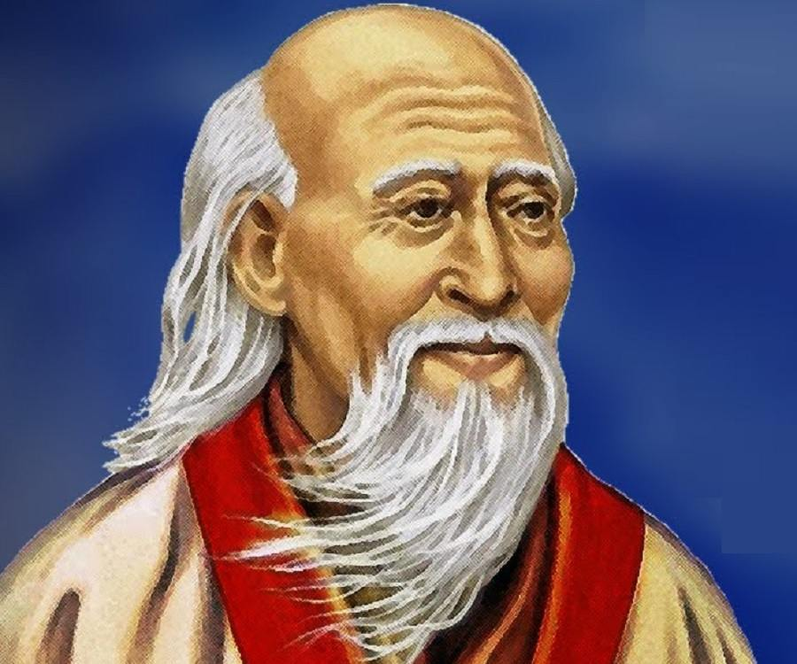
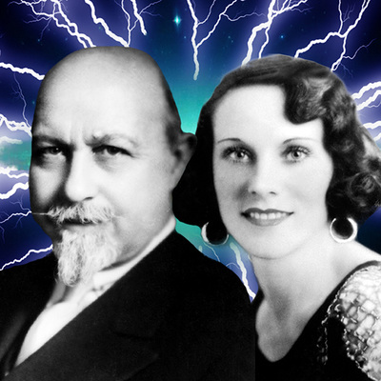
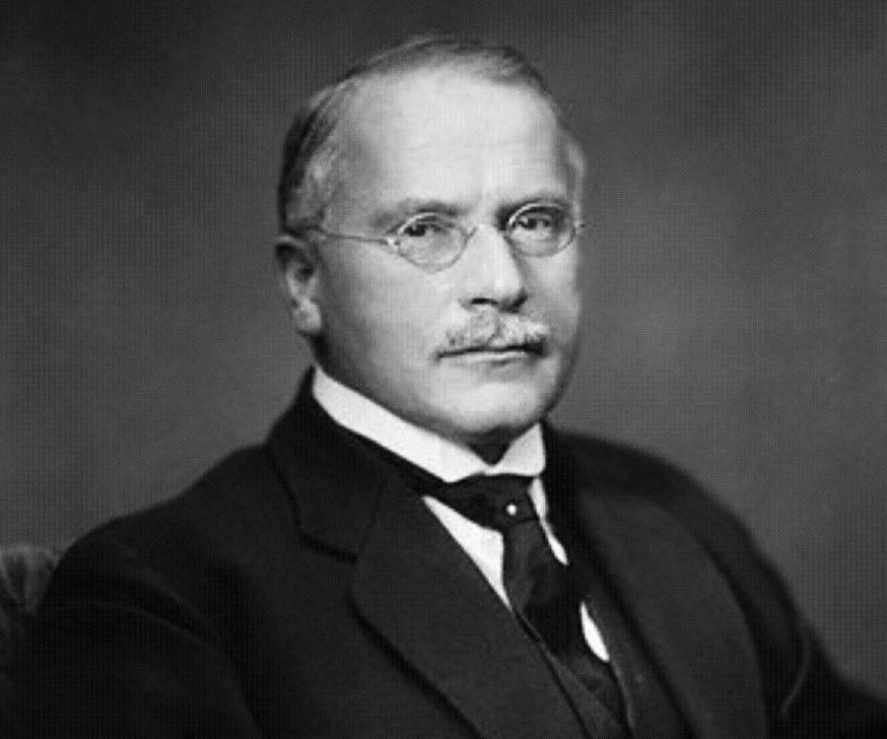
Balance GIANTS
Lao Tzu Mystic
The Way of Life
Walter & Lao Russell Illuminates
Teachers of Universal Law, Natural Science & Living Philosophy
Carl G. Jung Author, Psychologist
The Science of Mind
YOU? The Self
The Universe is Unlimited to the Degree You Know it is

Slide 36
Balance Optimizes Perfomance

Slide 37
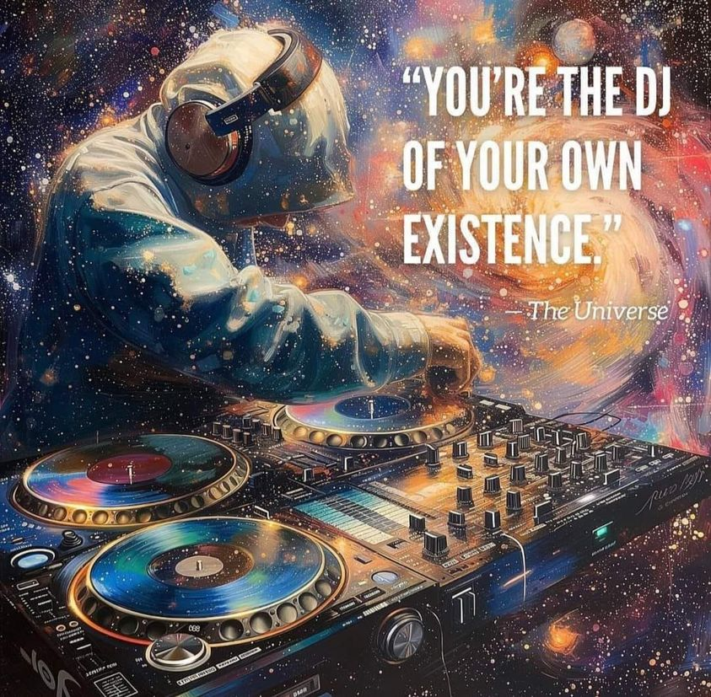
Get Mixing!

Slide 38
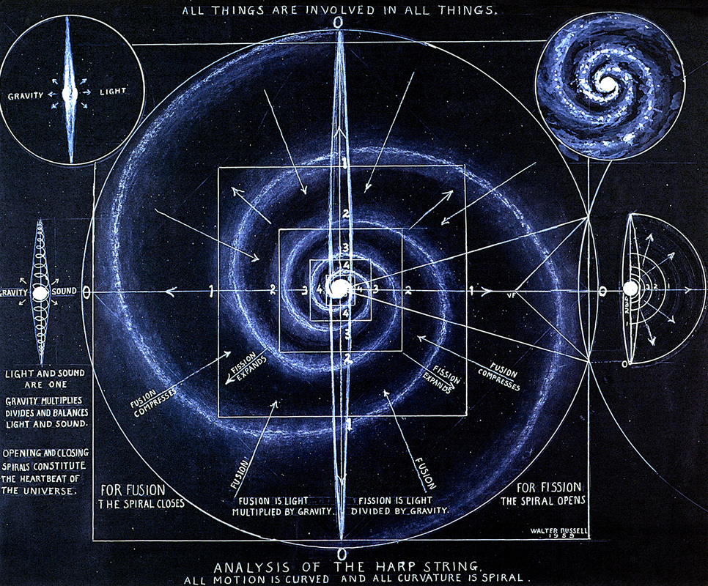
Workshop
Wednesday, February 14th 11:20am-12:50pm.

Slide 39
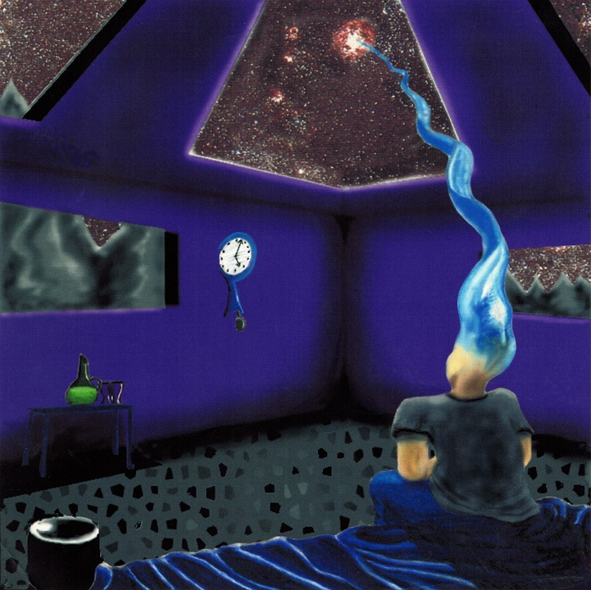
THANK YOU!!! QUESTIONS
www.Philosophy.org
ANARCHAPULCO20
www.MattPresti.com

